Slide 1

Design Review by Team 1
Introduction
Research
Design
Conclusion

Slide 2
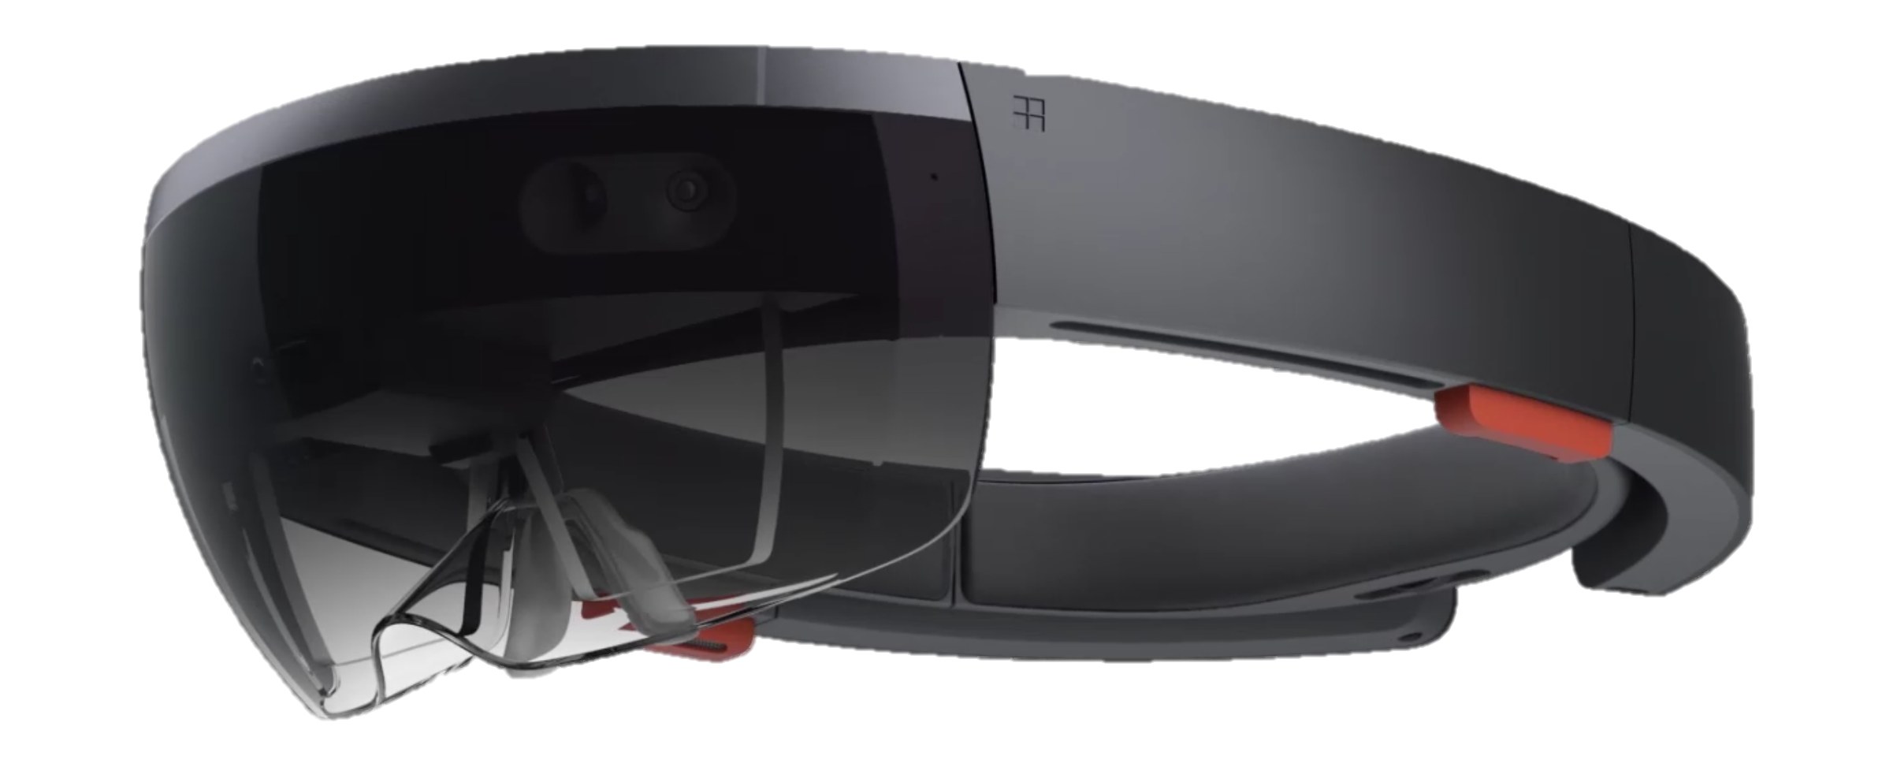

Introduction
Application requirements
An augmented reality play space
Facilitate play for autistic users
Assist with targeted user issues
Target audience
Children aged 8-13
Level 1 & 2 autism spectrum disorder
Trying to play with children with or without autism

Slide 3



Overview
Application core features
Top Trumps style card game
Character models augmented onto cards
Simple and easy to learn rules
Gameplay which encourages interaction
Additional features
Accessibility options
Selection of card themes
Gesture commands
Simplified user interface

Slide 4
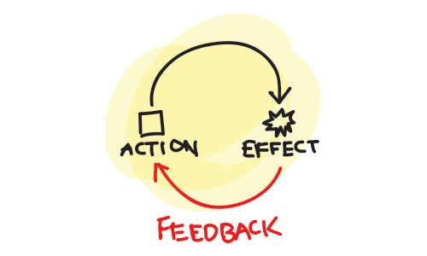
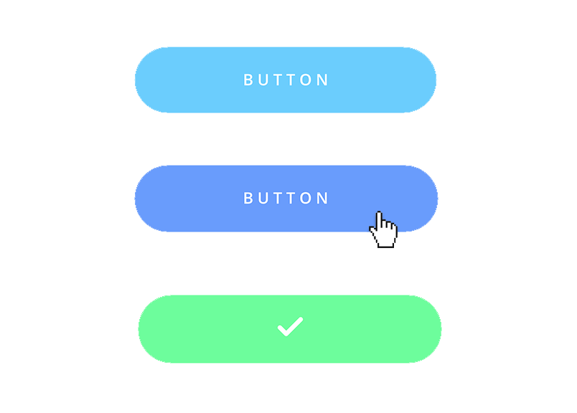
Research
User Interface
Bold, representational icons
Clear and intuitive UI elements
Uncluttered and prioritised
Gesture interaction
Interaction
Clear feedback for user action
Visual and audio feedback

Slide 5
Design
User Interface
Simple and uncluttered
Consistent layout throughout
Maximizes game view
Physical cards
Colourful and distinct
Unique with many features

Slide 6
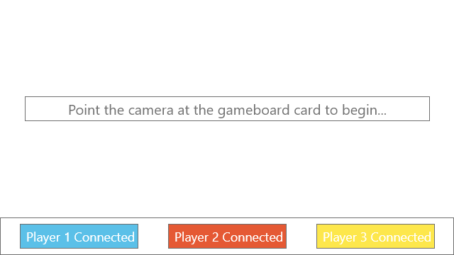

Slide 7
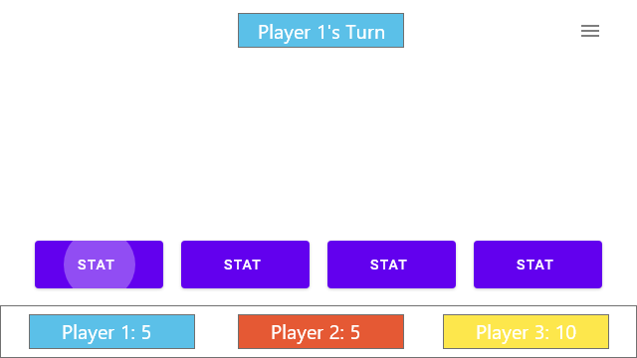

Slide 8
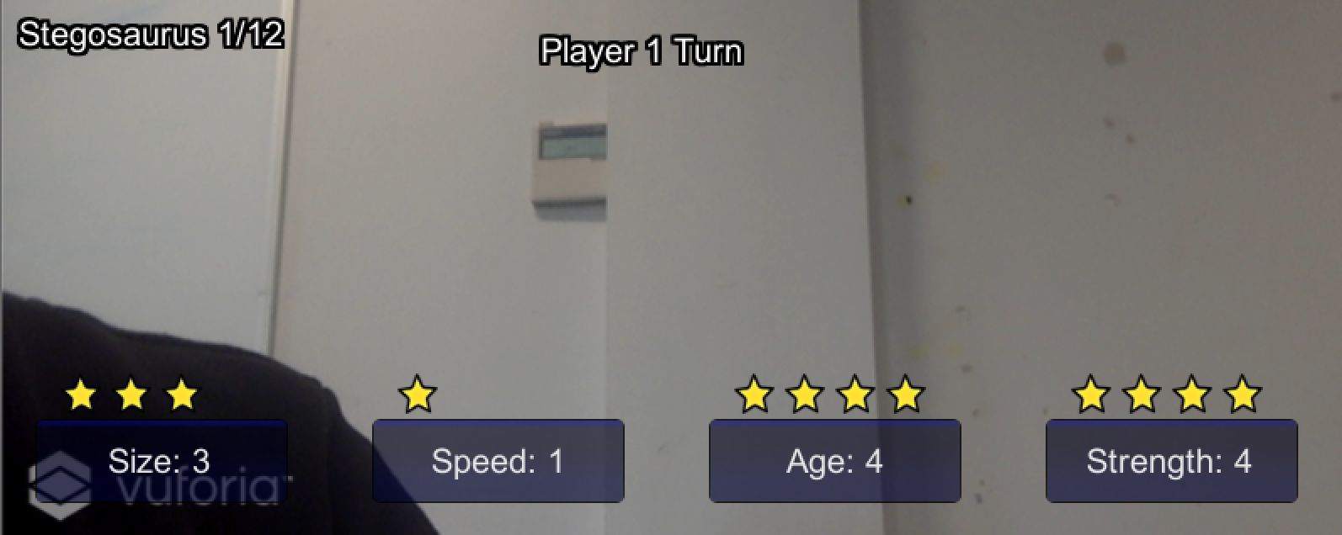
Deck view
Player view
Attribute score
Buttons

Slide 9
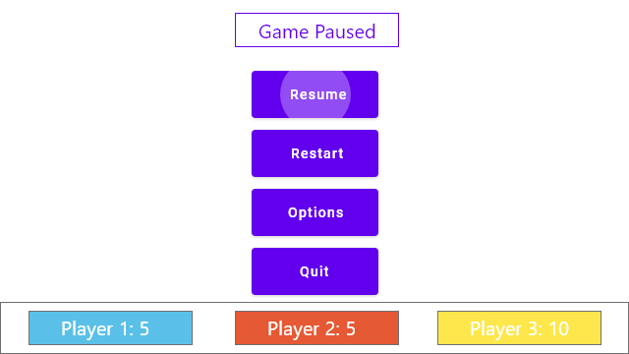

Slide 10




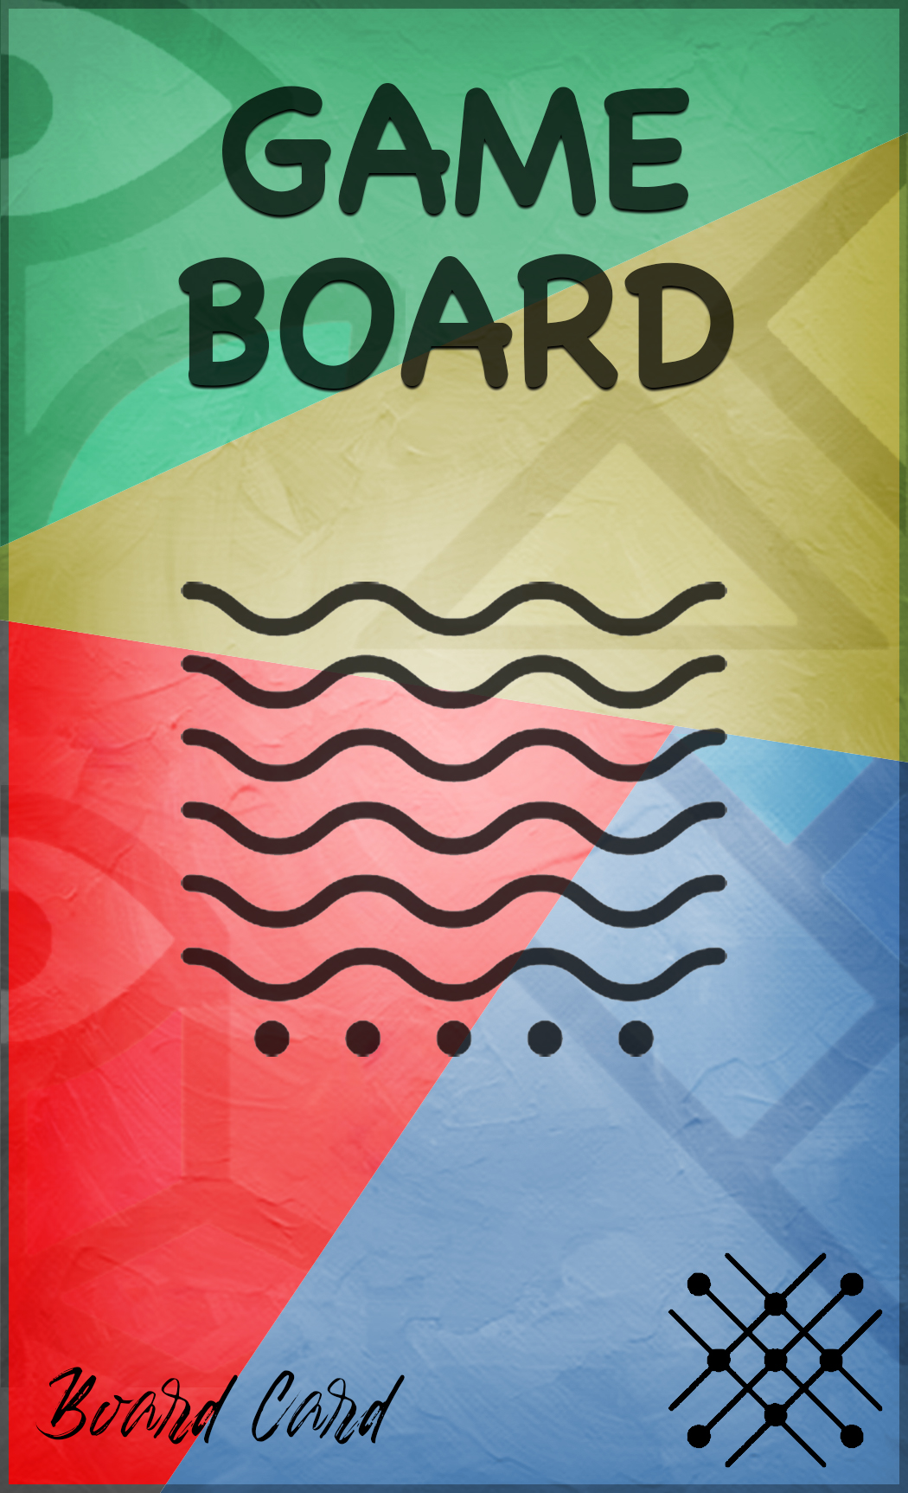

Slide 11
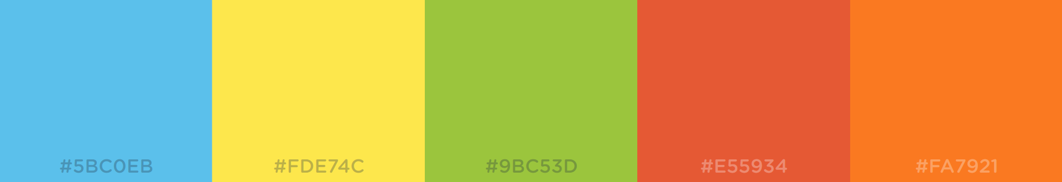
Colour Scheme
Warm colour shades to reduce eye strain
Distinct contrasting colours
Consistent use throughout application

Slide 12
Conclusion
Overview
Top Trumps style card game
Children aged 8-13 with autism
Design
Accessibility for our users prioritised
Augmented reality usability considered
Added functionality to further help autistic users
Any questions?

